Slide 1
Saving pins and power with integrated voltage converters
Michael Barrow A53046137

Slide 2
Introduction
Future CPUs will trade pins to be slow or dumb
Package pin limits are not scaling fast enough
Slow CPU’s sacrifice power pins for IO
Dumb CPU’s sacrifice IO for power pins

Slide 3
Introduction
Integrated DC DC power converters improve the pin exchange rate
Ohms law implies power pins can be saved with integrated converters
Intel demonstrate improved trade-offs with Haswell vs Ivybridge
Literature review explores optimizing power and IO with integrated CMOS converters

Slide 4
Operation of the DC DC converter

Slide 5
Popular step-down DC DC Converters
Step-down Switching DC DC converters enable pin optimization
Switching converters are power efficient voltage converters
Inductor-capacitor buck and switched capacitor are most popular
Integrated converters can leverage stable discrete designs

Slide 6
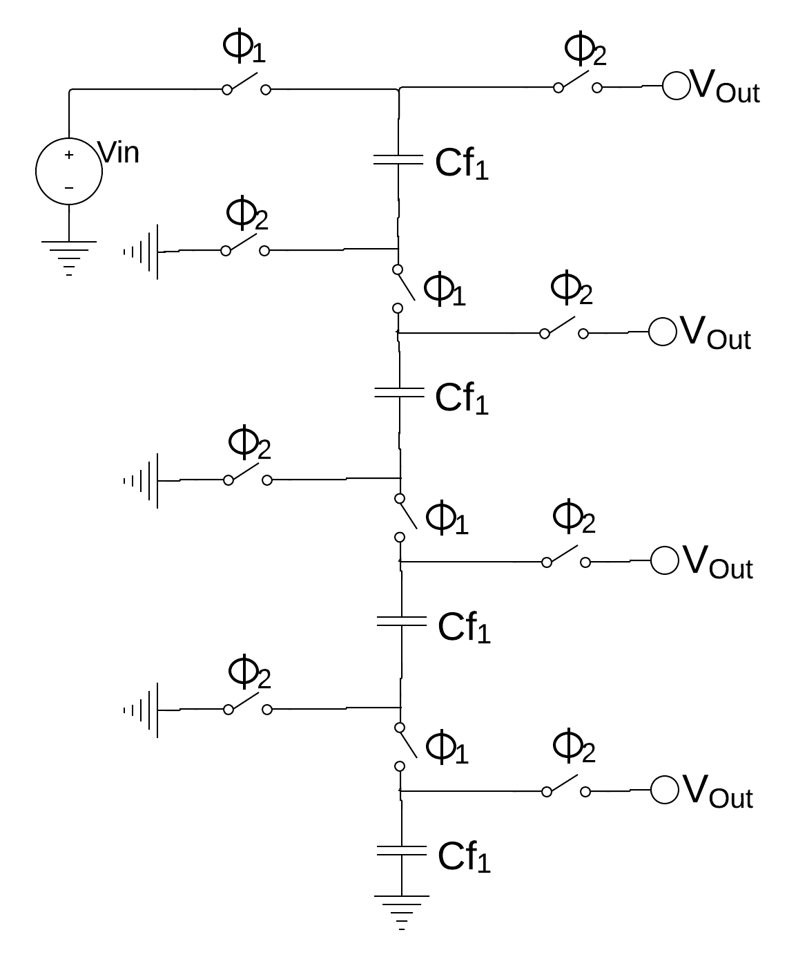
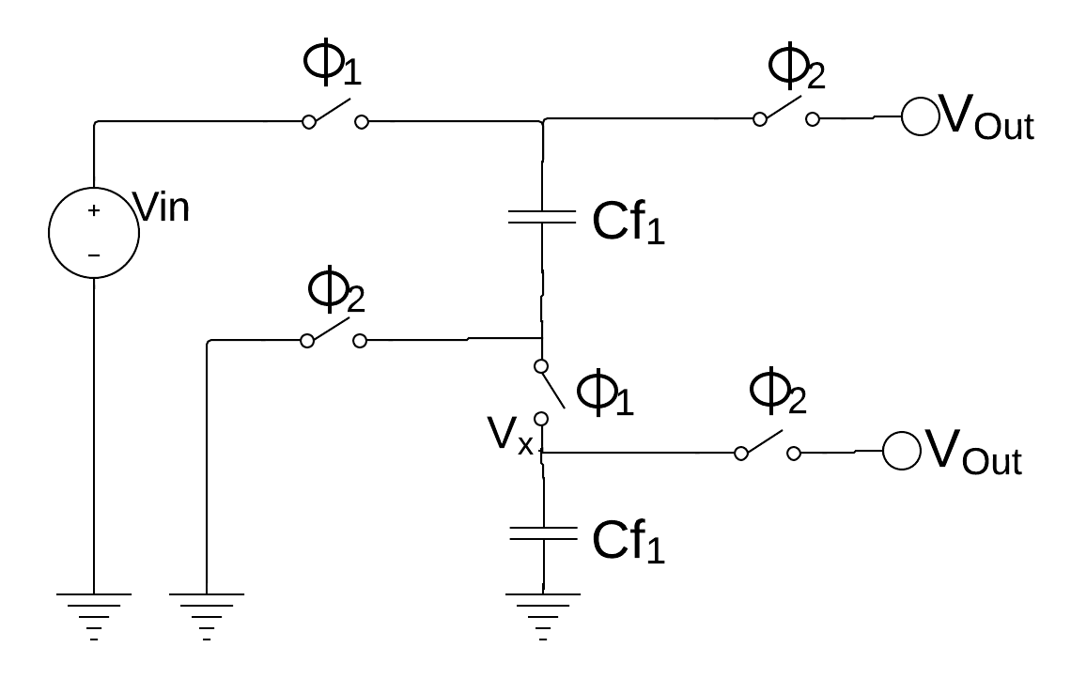
Switched Capacitor step-down type
Vout controlled with the ratio of parallel capacitance seen by the load
Splitting flying capacitance in half gives ½ stepdown
Splitting into four gives ¼ stepdown etc.
Fig 1: ½ step-down SC topology
Fig 2: ¼ step-down SC topology

Slide 7
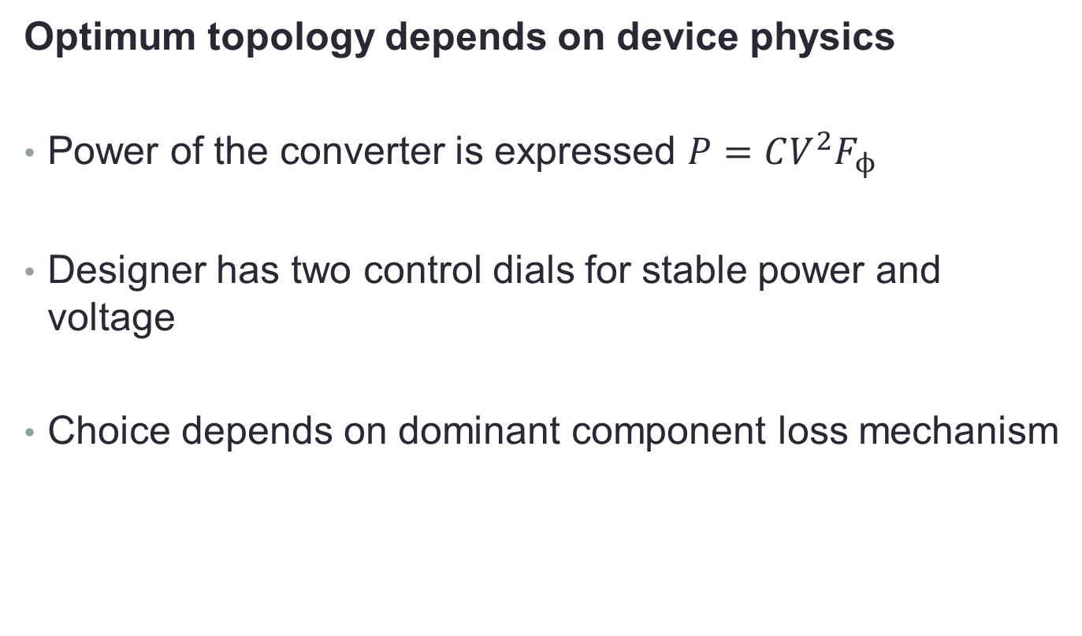
Optimum SC topology
Optimum topology depends on device physics
Power of the converter is expressed $P=CV^{2}F_{ϕ}$
Designer has two control dials for stable power and voltage
Choice depends on dominant component loss mechanism

Slide 8
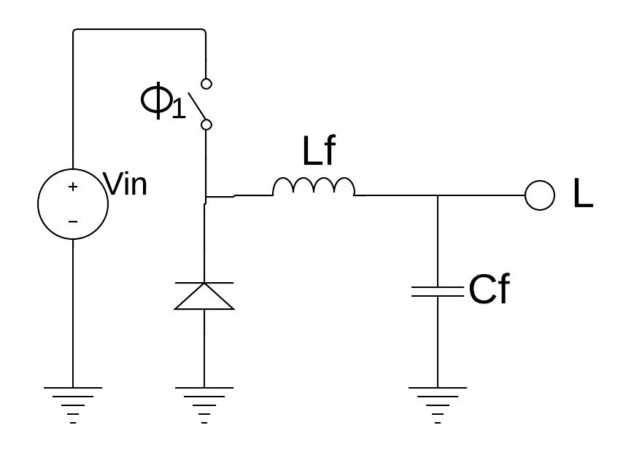
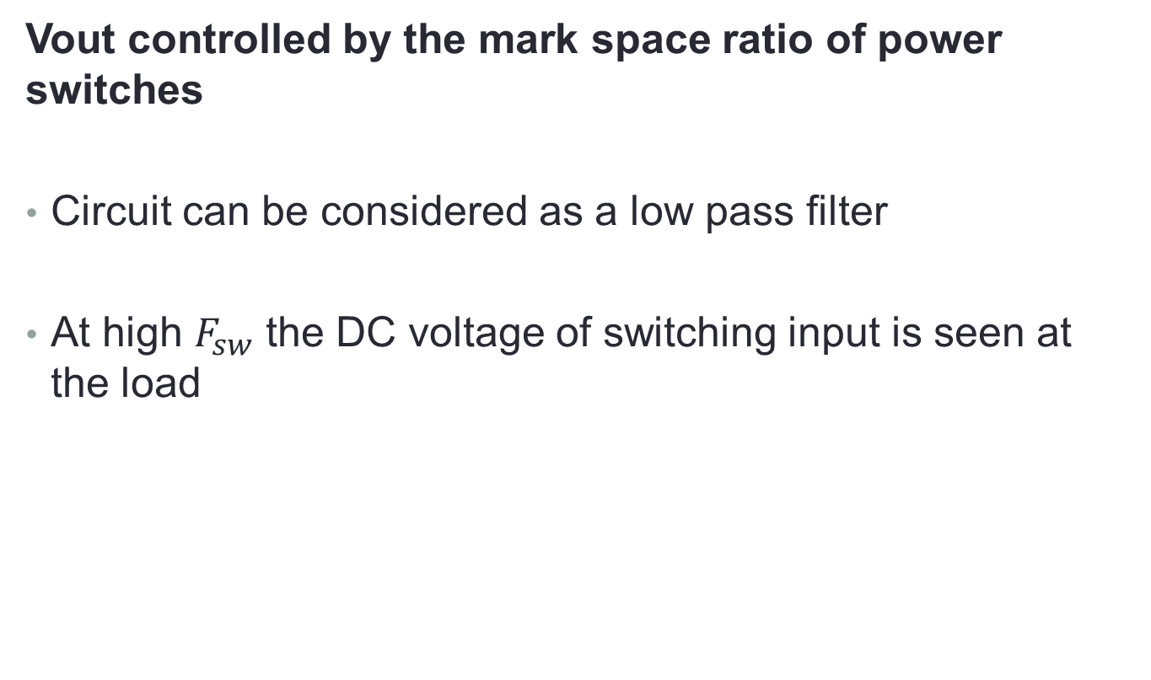
Inductor-capacitor step-down type
Vout controlled by the mark space ratio of power switches
Circuit can be considered as a low pass filter
At high $F_{sw}$ the DC voltage of switching input is seen at the load
Fig 2: Basic buck topology

Slide 9
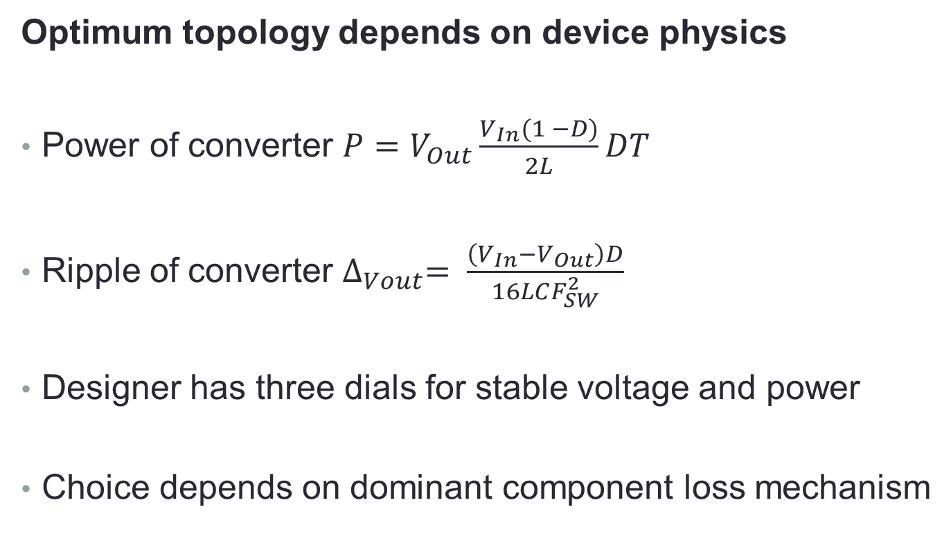
Optimum buck topology
Optimum topology depends on device physics
Power of converter $P=V_{Out}\frac{V_{In}(1 −D)}{2L}DT$
Ripple of converter $∆_{Vout}= \frac{\left(V_{In}−V_{Out}\right)D}{16LCF_{SW}^{2}}$
Designer has three dials for stable voltage and power
Choice depends on dominant component loss mechanism
Notes:
For Equn 1 Vin Vout andtherefore D are fixed, so only T and L may vary

Slide 10
General losses in DC DC converters

Slide 11
Switching losses
Switching losses determine quality of F and T dials
Relatively high losses require dialing down F and T
Dialing down F and T increase Vout ripple
Dynamic loss increases with F and T
Static loss constant due to current leakage to ground
Conduction loss constant for any power transfer

Slide 12
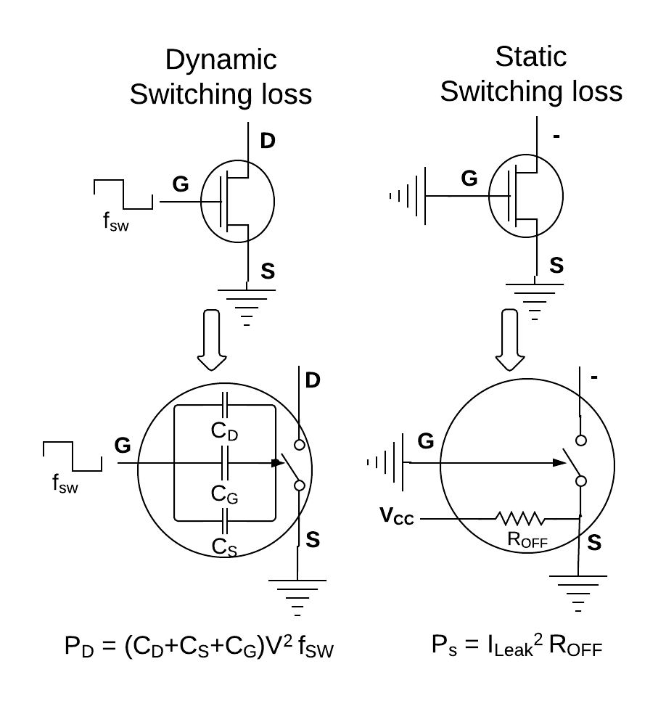
Switching losses
CMOS switches typically dominated by dynamic losses
Fig 4: Switching losses

Slide 13
Capacitor losses
Can be compensated for in buck but not in SC
The result of unwanted parasitic passive components
Equivilent series resistance loss
Unwanted resistivity of the device
Parasitic capacitance loss
Un-usable capacitance of the device

Slide 14
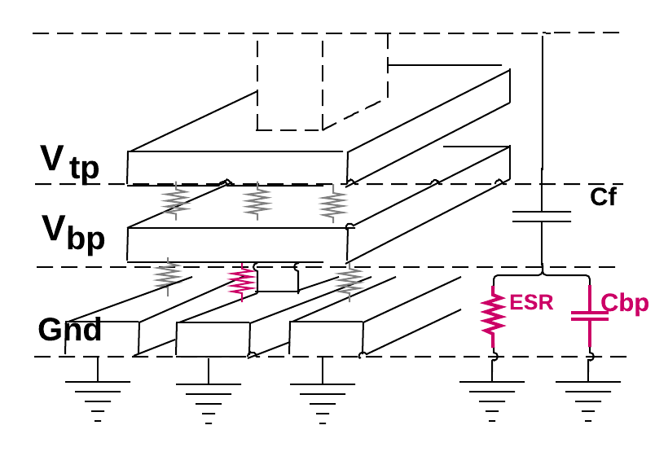
Capacitor losses
CMOS capacitor loss typically dominated by plate parasitic
Fig 5: Capacitor losses

Slide 15
Inductor losses
Present in buck only and determine buck power efficiency
The result of unwanted parasitic passive components
Equivalent series resistance loss
Directly proportional to inductance
Parasitic inductance
Negligible in simple circuit topologies

Slide 16
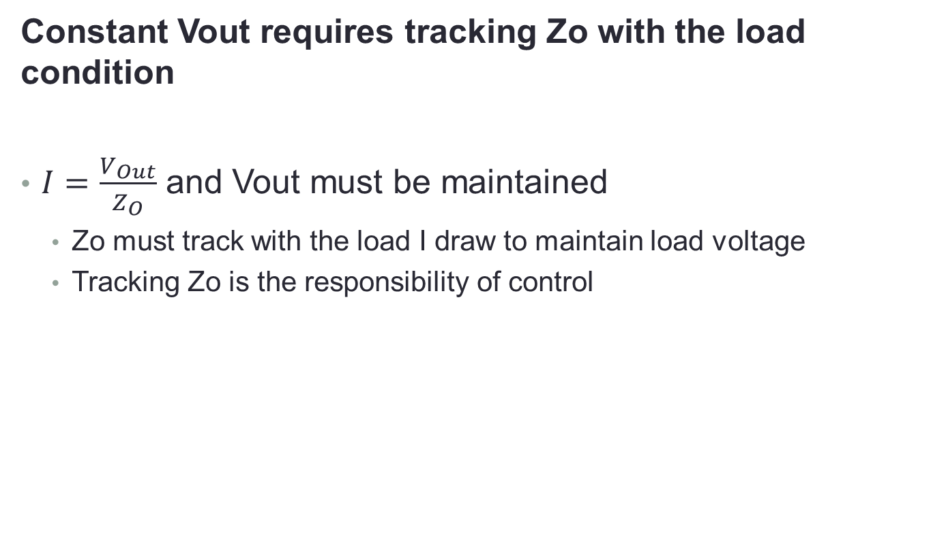
Converter load regulation losses
Constant Vout requires tracking Zo with the load condition
$I=\frac{V_{Out}}{Z_{O}}$ and Vout must be maintained
Zo must track with the load I draw to maintain load voltage
Tracking Zo is the responsibility of control
Notes:
Buck has better Zo control than SC

Slide 17
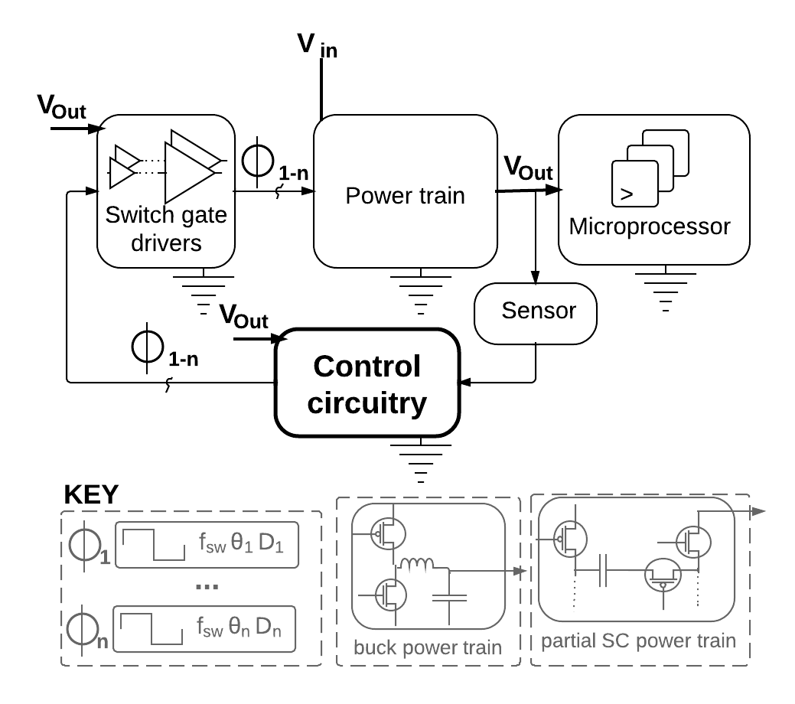
Converter load regulation losses
Constant Vout requires tracking Zo with the load condition
Fig 6: Control block diagram
Notes:
Buck has better Zo control than SC

Slide 18
Best design for Integrated converters
Best integrated converter an open research question
Arguments for SC | Arguments for Buck
Capacitance easy to implement MOSFET gate cap is basic CMOS block | Inductors can be implemented in CMOS without process modification
Inductor parasitic impedance grows with Inductance Capacitor impedance shrinks with capacitance | Buck design has been prefered for >100mW for several decades Why change?
Table 1: Converter type arguments
Notes:
NO basic inductance building block in CMOS

Slide 19
Design of Integrated DC DC Converters

Slide 20
Interest is power system replacement
Integrated performance must be comparable to discrete
Must be capable of driving typical CPU power envelopes
Inefficient switched converters not appropriate for current and emerging power sensitive chips
Literature concerning LDO replacement beyond review scope

Slide 21
Baseline CMOS SC
Power density was lower than expected
High parasitic capacitance not anticipated or modeled
Result was low power density
1600pF capacitance and 1.7mW/mm2 for baseline SC
1.1nF capacitance and 20mW/mm2 for baseline buck
Standard CMOS capacitors insufficient for efficient converters
Notes:
Lower than expected efficientcy

Slide 22
Baseline CMOS buck
Efficiency too low even for LDO replacement
Design rules of thumb did not apply to integrated converters
Switching loss reduction technique worstened load regulation
Low Q inductors result in very high conversion loss
Max 46% Efficiency was lower than both baseline SC and an LDO
Standard CMOS inductors insufficient for efficient converters
Notes:
Tried to use ZVS technique zero voltae switching. Leakage is killing them at low voltage

Slide 23
Improving the baseline
Research harnesses the strengths and addresses the weaknesses of integration
Early CMOS designs adjusted expectations of the research community
A branch of research improves on component limitations
A branch explores integrated architecture potential
Notes:
Integrated architecture potential? You get more complexity. You can have hundreds of components and circuits doing the work of one or two in discrete designs

Slide 24
Integrated switch research
Work to increase efficiency and operating voltage was reviewed
Switches on die with a CPU load must operate above the load voltage to reduce power pins
Loads operate at ≈ 1V, batteries 3.7V, wall socket 110V
Losses are critical due to orders of magnitude higher toggle rate
Baseline CMOS exhibits high switch leakage

Slide 25
Integrated switch efficiency circuits
Limited success in forwarding power switch energy to the load
Switch gate charge recycling technique
Energy for toggling power switches is recycled
Gate capacitor charge is pumped to the load and not ground
Attempted in buck and SC designs
Consistently abandoned in future work

Slide 26
Integrated switch efficiency circuits
Successful but costly switch energy oscillator demonstrated
Resonant gate driver
Integrated inductor in series with switch gate
Creates a resonating energy tank to toggle power switch
Attempted in buck only
Parasitic effect at non resonant Vout
30% reduction in converter energy density

Slide 27
Integrated switch efficiency circuits
Incremental voltage drop switches demonstrated diminishing efficiency
Stacked switch voltage cascade step-down
Each switch in a daisy chain drops a fraction of Vin
An arbitrary voltage may be dropped with high enough stack
Higher stacks have increasingly complex gate switch circuits
Diminishing efficiency due to increasing conduction loss
Diminishing efficiency due to increasing gate capacitance

Slide 28
Integrated switch technology options
Switch technology is lightly explored
High voltage integrated converters are lightly explored
DEnMOS applied as a component of switch daisy chain
LDMOS and GAN switches beyond operating envelope of reviewed work
GAN outperforms MOS switches in the high corner
Lower high frequency loss
Better high power density
Higher breakdown voltage
Notes:
If we need to increase anything above what is seen in the literature (all pretty low voltage energy density)
We should use LDMOS for cheap cost and GAN for high performance

Slide 29
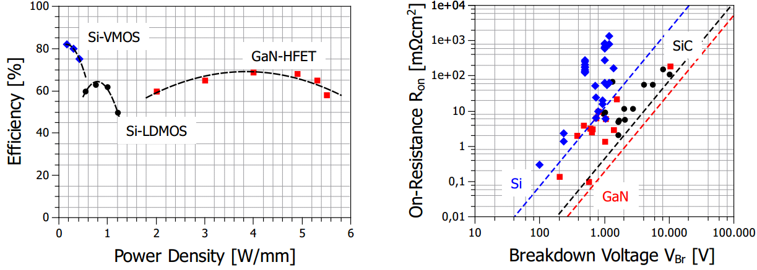
Integrated switch technology options
Optimum switch choice depends on load power envelope
Fig 7: Switch performance:
Source Kraue, D. High power algan, gan hfets for industrial, scientific and medical applications. Diss. Universittsbibliothek Freiburg 2013
Notes:
If we need to increase anything above what is seen in the literature (all pretty low voltage energy density)
We should use LDMOS for cheap cost and GAN for high performance

Slide 30
Integrated switch research conclusions
Non-standard CMOS/alternate switches increasingly attractive with increasing voltage and power demands
Switches on die with a CPU load must operate above the load voltage to reduce power pins
Loads operate at ≈ 1V, batteries 3.7V, wall socket 110V
Losses are critical due to orders of magnitude higher toggle rate
Baseline CMOS exhibits high switch leakage

Slide 31
Integrated inductor research
Flux is improved with custom layout
Angular spiral inductors have inadequate Ql for power converters
Coreless custom layout racetrack inductors were characterized
Inductor resistivity still dominated losses in 7mA test configuration
Notes:
Custom layout is required to put curves in the inductors. Why do you need the curves? Uniform field? Find out!

Slide 32
Integrated inductor research
Harnessing parasitic inductance was explored
Die bond wire proposed as integrated inductor substitute
Relatively high inductance and 0 die area cost
May be further enhanced with magnetic cores
Unsuitable for pin optimization due to intrinsic Power:Pin-count loss

Slide 33
Integrated inductor research
Exotic materials required for high energy density
Thin film magnetic process step explored
Process step applied to custom layout racetrack inductors
Energy density and Ql sufficiently high for all processor power envelopes
Currently require fabrication on specialized interposer
Notes:
Custom steps and curved racetrack mean these cannot be integrated into standard CMOS. Expensive to manufacture

Slide 34
Integrated inductor research conclusions
Inductor quality factor research most successfully applied
Q factor is suitable for largest power envelope
Inductors integrated to the most sophisticated converters
Technology commercialized by Intel in Haswell

Slide 35
Integrated Capacitor research
Energy density improves efficiency and operating envelope so is heavily explored
Thin gate MOSFET applied
Higher Q than CMOS gate cap
Higher energy density than CMOS gate cap
Comparable parasitic losses

Slide 36
Integrated Capacitor research
Energy density improves efficiency and operating envelope so is heavily explored
MIM capacitors commonly applied
Feature Higher Q and lower losses than CMOS gate cap
Lower parasitic losses
Higher Q costs energy density

Slide 37
Integrated Capacitor research
Exotic materials required for practical energy densities
Deep trench ferroelectric applied
Increased Q due to physical structure
Increased energy density due to ferroelectric permittivity
Permittivity of bottom plate becomes negligible
Energy density is lower than expected

Slide 38
Integrated Capacitor conclusions
Practical high energy density capacitors still open research question
CMOS gate capacitors
Relatively low Q and energy density
MIM capacitors
Relatively high Q and low energy density
Deep trench / ferroelectric capacitors
Highest Q and energy density, still immature
Notes:
Researchers don’t have capacitors as energy dense as the inductive counterparts
Often still just assumed that Capacitors beat out Inductors
Weakness of capacitors less well understood than weakness of Inductors. UCB Sanders Vincent Ng seem only team to put out equations relating to capacitive performance

Slide 39
SC Architecture research
Focus is addressing poor load regulation and rail noise
SC Converters do not have a built-in low pass filter
Line voltage ripple is high due to the exponential discharge of power capacitors
Architectural techniques to mitigate this are explored
SC Converters do not have a discontinuous current mode
Clumsy impedance modulation due to single component sourcing voltage and current
Architectures exploiting high integrated component count are explored
Notes:
DCM mode is a buck converter thing where you exploit having two components to get high converter impedance. You put very little energy into the inductor. Votage is maintained at the capacitor because you have a light load discharging it.

Slide 40
SC Architecture research
Regulation efficiency curve improved from exponential to linear piecewise
Multiple conversion ratios give multiple curves
Converters with Re-configurable conversion ratios are presented
Each configuration has a max efficiency operating point
Control circuitry selects best exponential based on load condition
Notes:
DCM mode is a buck converter thing where you exploit having two components to get high converter impedance. You put very little energy into the inductor. Votage is maintained at the capacitor because you have a light load discharging it.

Slide 41
SC Architecture research
Regulation efficiency curve improved from exponential to linear piecewise
Capacitance modulation improves impedance matching
Out capacitance is cut into multiple parallel slices
Control circuitry connects as much as needed to the drive and load
Switch conductance modulation improves impedance matching
Analogue control of impedance is possible for fine grain impedance matching
Undesirable efficiency as operating principle mimics LDO’s

Slide 42
SC Architecture research
Line noise improved with slice phase modulation
Impedance matching slices operate out of phase
Exponential voltage discharge curves are superposed
Maximum phase shift results in minimal ripple
May be applied aggressively since current path is not reduced
Notes:
Apply aggressively but you don’t get a linear improvement. Pique has 16x improvement over a baseline, but he has 41phases vs 10…

Slide 43
SC Architecture research conclusions
Impedance modulation limit remains but architectures improve control
SC architectures still have worse current choke control than buck
Supply and load electrically isolated
Relatively weak drive capacity issue remains
SC Impedance control demonstrated as comparable to buck
Integrated converters able to surmount previous poor control
Baseline efficiency issues satisfactorily addressed
Notes:
You cant short circuit drive to load as you can in buck, so you have weak drive constrained by what the capacitor tank can store.
In the buck you are limited to what the inductor can handle before melting, not what energy the tank can store

Slide 44
Buck architecture research
Focus is optimizing component size and efficiency
Use of inductor and capacitor components facilitates complex architecture
Complex filter and tank topologies are explored
Availability of abundant high speed transistors exploited
Complex control methods are explored
Notes:
SC does not use inductor components, so the architectural exploration space is limited to capacitor only architectures and limited to capacitor only device physics

Slide 45
Buck architecture research
Light load efficiency improved with control
High speed control circuits developed for integrated converters
Integrated bucks switch orders of magnitude faster than discrete
Low latency circuits developed for responsive feedback control
Architecture is unsuitable for moderate-heavy loads
Architectures for better load curves are explored
Harness component slicing technique similar to integrated SC
Sophisticated mode switching based on load condition explored
Architecture is suitable for moderate-heavy loads
Notes:
Control circuits employed in DCM (hysteresis) mode, where D does not apply. Circuits typically CANNOT be applied to DCM, they SINK CURRENT

Slide 46
Buck architecture research
Component size is reduced with complex topology
Multiple topologies of flying capacitor buck are explored
Flying capacitor buck demonstrated a 50% total reduction in required capacitance
Extra capacitor allows more sophisticated transfer function
Filter attenuation can be better tuned to switch frequency

Slide 47
Buck architecture research conclusions
Architecture shown to optimize component size and converter performance
Control demonstrated for typical frequencies of integrated buck
Circuit topologies reduce integrated component size
Architecture improvements second order to component performance
Notes:
Yeah you can see some improvements of x% but you are still hovering at 6x%. That sucks compared to discrete and its because of passive component and switching loss. That stuff is the big deal

Slide 48
The IO limit with integrated DC DC Converters

Slide 49
High speed IO suffers decreased SNR
A review of Intel processors from the past three decades catalogues decreasing IO SNR
IO Bus width and frequency increased significantly from 4004 to pentium
Bus trace attenuation not critical due to acceptable PCB trace SNR
Only bus frequency increased from pentium to 2nd generation core
Bus lengths consistently shrank to maintain PCB trace SNR
Switch to fully differential IO from 2nd generation core to present
Common mode noise rejection required for acceptable SNR

Slide 50
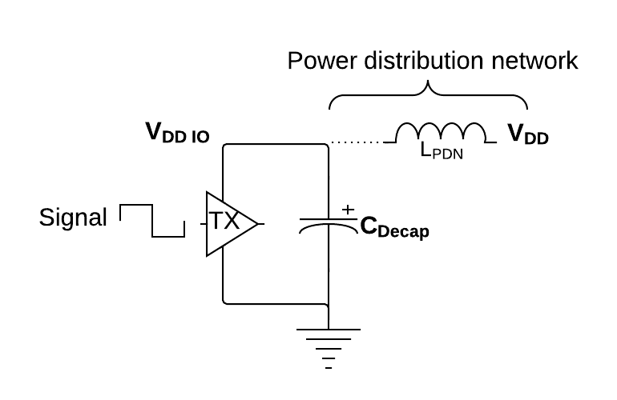
IO pin performance and DC-DC converters
Integrated converters respond faster to transient IO supply droop
IO supply compromised because of transient voltage droops
Bursts of activity drain supply capacitance
Fig 8: IO buffer voltage droop

Slide 51
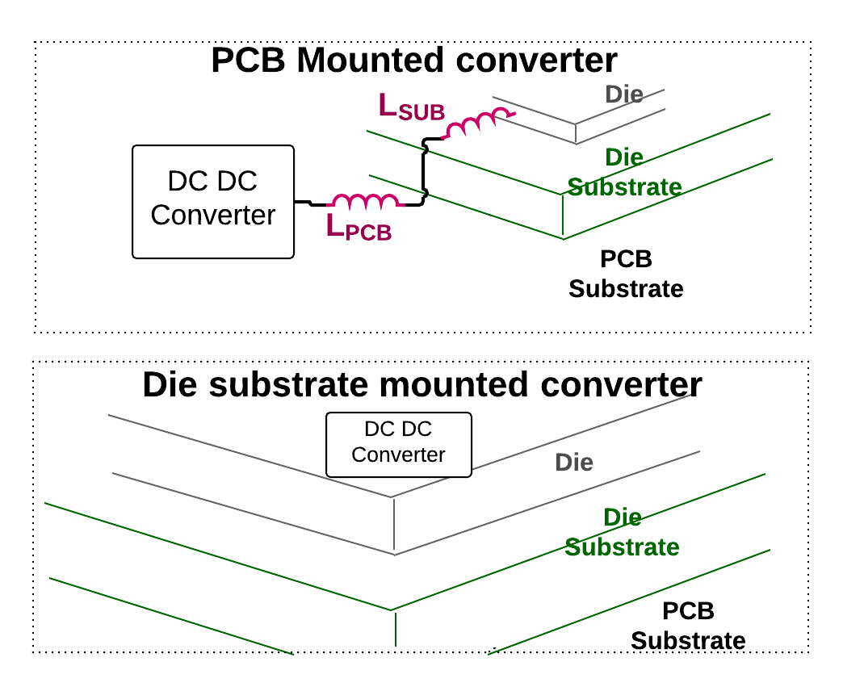
IO pin performance and DC-DC converters
Integrated converters respond faster to transient IO supply droop
Integrated converters able to respond faster to voltage droops
Control loop path has less inductive delay
Supply voltage restored faster than discrete converter

Slide 52
IO pin performance and DC-DC converters
Integrated converters offer fine grain voltage droop control
Power distribution network charge wells are distributed
Capacitance often sliced for control mechanisms
IO Buffer voltage droop often distributed
E.g. IO regions distributed to maintain proximity to a corresponding core
Bursty activity creates droop at localized region
Distributed control can address localized droop
Nearest charge well can increase drive to restore local Vdd

Slide 53
IO pin performance conclusions
Increasing IO bandwidth with DC DC converters is lightly explored
Lack of appropriate converters a limiting factor
Lack of appropriate load a limiting factor
Notes:
Not many DC DC converter specialists have a multi-core high speed IO design kicking around that has well characterized transient droops limiting IO bandwidth

Slide 54
Saving pins with DC DC converters
High power density passives have historically limited exploration
Ohms law suggested pin optimization requires high power density passives
Few researchers presently have access to high power density inductors
Suitable high power density capacitors still work in progress
Small subset of the literature considers converters operating above Li-Ion batteries

Slide 55
High voltage SC-buck
Minimal demonstration of high voltage high energy density integrated converter concept
Solves technology issues of slow LDMOS high voltage switches
Relatively large capacitance takes advantage of slow switching
Solves SC limitations of load regulation and ripple
A buck stage implemented for post regulation
Buck uses fast nominal voltage power switches
Features relatively high power density
Ohms law stepdown requires energy density beyond integrated caps
Semi-integrated capacitors employed to demonstrate concept
Notes:
Large energy transfer during the slooww switching
Large energy ripple can be accounted for by the buck
Inductor would be the choke point for power, but it can be effectively short circuited to the decoupling capacitance thanks to its cool impedance reducing property

Slide 56
High voltage substrate transformer-buck
Limit of semi-integrated passives for high voltage high power density
Reviewed high power designs apply semi-integrated passives
Substrate transformer buck embeds inductor and transformer within PCB substrate
Highest performance corner in drive, voltage and efficiency
IO count optimization potential limited by planar substrate obstruction

Slide 57
Integrated converter pin saving conclusions
A Lack of exploration was identified
Practical semi-integrated converters were found
Reviewed work has limited power capabilities or limited pin count optimization utility

Slide 58
Directions for future work

Slide 59
Standard CMOS SC/Buck
Augmentation to the reviewed literature is postulated
Evolutionary comparison of work eliminates several classes of converter
Design | Converter type | Integration | Special technology | Efficiency | Energy density
Substrate transformer | Transformer buck | None | None | 96% peak | 1.5W/mm2
CMOS buck | Buck | Full | None | 58% peak | 0.2W/mm2
Bond wire buck | Buck | Semi | None | 82.4% peak | 0.86W/mm2
Thin film inductor buck | Buck | Semi | Interposer & thin film inductors | 69% nominal | 22.6W/mm2
SC inductor buck | SC buck | Semi | Unknown | 81% peak | 0.08W/mm2
Table 2: Converter evolution

Slide 60
Standard CMOS SC/Buck
Augmentation to the reviewed literature is postulated
Evolutionary comparison of work eliminates several classes of converter
Design | Converter type | Integration | Special technology | Efficiency | Energy density
Substrate transformer | Transformer buck | None | None | 96% peak | 1.5W/mm2
CMOS buck | Buck | Full | None | 58% peak | 0.2W/mm2
Bond wire buck | Buck | Semi | None | 82.4% peak | 0.86W/mm2
Thin film inductor buck | Buck | Semi | Interposer & thin film inductors | 69% nominal | 22.6W/mm2
SC inductor buck | SC buck | Semi | Unknown | 81% peak | 0.08W/mm2
Table 2: Unsuitable converters for full integration
Notes:
Standard CMOS is not efficient enough to reduce IO pin ratio (peak efficiency is really not representitive)
Substrate transformer blocks both IO and power pins
Bond wire buck consuming substrate pin pads for power inductors can never reduce the power to IO pin ratio

Slide 61
LDMOS High voltage SC-Buck
Research questions concern efficiency and power density
Literature review suggests high voltage power switch performance scales well with voltage
Power density may be improved with integrated deep trench and ferroelectric capacitors
Eliminates need for semi-integrated design
Reduces charge well inductance path and improves control
Efficiency may be improved with architecture techniques
Double stage design is a complex voltage filter
Component sizing may be reduced with architectural methods similar to flying capacitor
Notes:
Power density is below many other works including bondwire inductor

Slide 62
GAN Interposer buck
Silicon interposer buck allows aggressive IO optimization exploration
SI interposer designs are state of the art in performance
Power density may be explored with all exotic components
Interposer allows GaN, thin-film inductors and ferroelectric capacitors to interface with standard CMOS CPU
Pin optimization may be attempted with cherry picked technologies
IO density limit may be explored
Interposer may be used to reduce substrate IO
Related work reduces memory IO pins by bridging memory dies to processor dies
Notes:
State of the art in performance, so we are building on the best

Slide 63
Conclusions

Slide 64
Optimizing IO with integrated converters is an open research question
Individual technologies enabling optimization identified but converter literature focusses on Li-Ion voltages
Limits of converter circuits and component research were reviewed
A dearth of literature on high voltage converters was observed
Methods applied to converter limits were found that scale to high voltage converters
Conjecture for exploring high voltage converters based on voltage scalable techniques and architecture are offered

